Slide 1
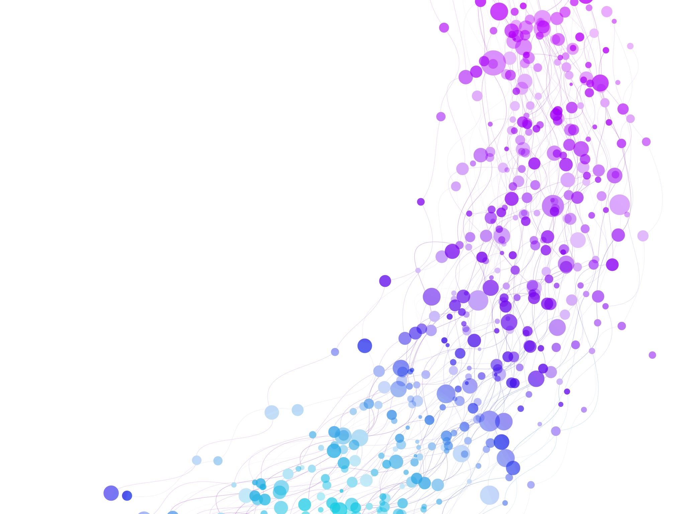


Arithmetic operations on matrices. Session No.: 7 Course Name: Data Strucutres Course Code: R1UC308B Instructor Name: Dr. Gaurav Agarwal Duration: 50 mins Date of Conduction of Class: 04 September 2025

Slide 2

Review
Pre-Requisite :
Application of arrays, Sparse Matrices, and their representations.

Slide 3
Arrays provide an efficient way to store and access data sequentially, making them fundamental in implementing other data structures.
Sparse matrices optimize memory usage by storing only non-zero elements, which is crucial for large datasets with many zero values.
Different sparse matrix representations (such as triplet representation and linked list representation) allow efficient storage and manipulation depending on the application requirements.
Understanding arrays and sparse matrices in C lays the foundation for solving real-world problems in scientific computing, image processing, machine learning, and optimization tasks.
Thus, mastery of these concepts enhances both memory efficiency and computational performance in data structure implementation.

Slide 4
Learning Outcomes
[2-mins]
By the end of this session, You will be able to:
Properties of matrix addition, subtraction, scalar multiplication, and matrix multiplication.
Apply matrix operations to solve mathematical and computational problems.

Slide 5
Session Outline
Introduction to Metrics
Types of Arithmetic operation
Provide hands-on activities and reinforce learning through an interactive WooClap and WooFlash tools.

Slide 6

[1-mins]
Activity-1 Think -Pair - Share
“What happens when we add two matrices of the same size?”
“Can we multiply any two matrices?”
Each pair presents their operation briefly with an example.

Slide 7
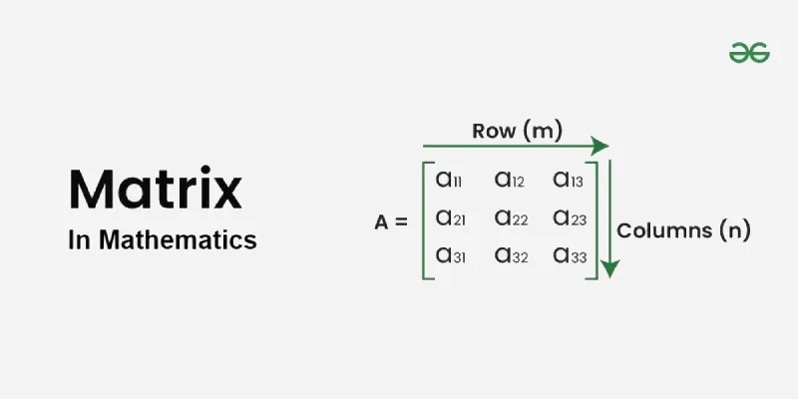
Concept and Definition for (LO-1)
Matrices
Matrices are key concepts in mathematics, widely used in solving equations and problems in fields like physics and computer science.
A matrix is simply a grid of numbers, and a determinant is a value calculated from a square matrix.

Slide 8
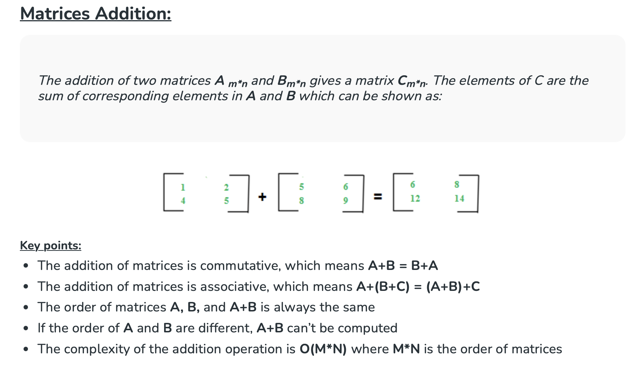
Different Operations on Matrices
Matrices Addition
Matrices Subtraction
Matrices Multiplication

Slide 9
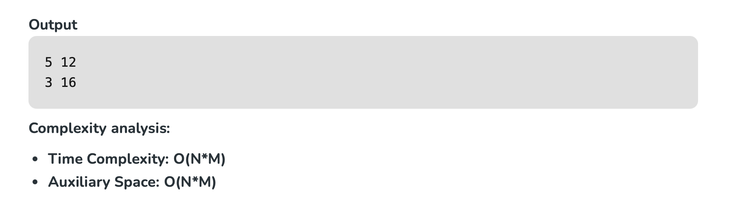
#include <iostream>
using namespace std;
int main()
{
int n = 2, m = 2;
int a[n][m] = { { 2, 5 }, { 1, 7 } };
int b[n][m] = { { 3, 7 }, { 2, 9 } };
int c[n][m];
for (int i = 0; i < n; i++)
for (int j = 0; j < n; j++) {
c[i][j] = a[i][j] + b[i][j];
}
for (int i = 0; i < n; i++) {
for (int j = 0; j < n; j++)
cout << c[i][j] << " ";
cout << endl;
}
}
[5-mins]

Slide 10
Key points:
Subtraction of matrices is non-commutative which means A-B ≠ B-A
Subtraction of matrices is non-associative which means A-(B-C) ≠ (A-B)-C
The order of matrices A, B, and A - B is always the same
If the order of A and B are different, A - B can’t be computed
The complexity of subtraction operation is O(M*N) where M*N is the order of matrices

Slide 11

Activity-2 wooflash

Slide 12
Assessment
Write the program of metrics multiplication

Slide 13
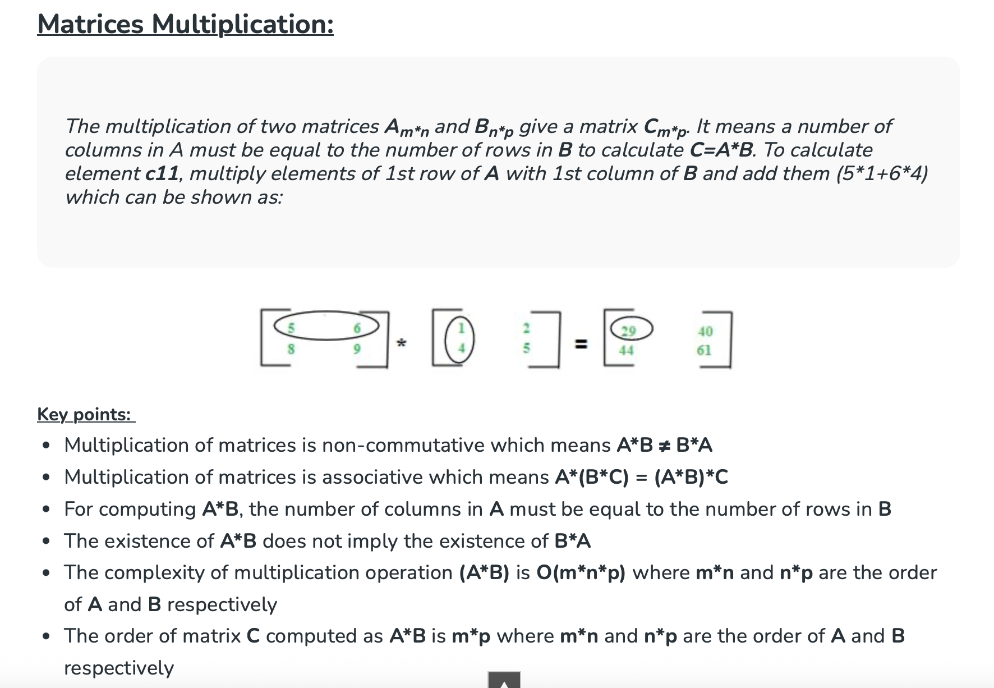
Summary
[1-mins]

Slide 14
[2-mins]
Ensure attainment of LO’s in alignment to the learning activities:
Properties of matrix addition, subtraction, scalar multiplication, and matrix multiplication.
Apply matrix operations to solve mathematical and computational problems.

Slide 15
[1-min]
Next Session:
Recursion: Tail recursion, Head Recursion.

Slide 16
Review and Reflection from students
Go to the LMS and fill out the feedback form

